Slide 1
Genetic Algorithm

Slide 2
Presentation Outline:
1) Introducing the 4-Queen problem
2) Activity: Solving 4-Queen problem using artifacts
3) Solution of 4-Queen problem in Backtracking approach
4) Demerits of Backtracking approach
5) Introducing 8-Queen problem
6) Discussion on Genetic Algorithm
7) Solution of 8-Queen problem using GA
8) Conclusion

Slide 3





The 4-Queen Problem
Once upon a time, there was a great king in India. However, it was a matter of shame that he had 4 Queens. The Queens were so arrogant and they didn’t even want see one another. Therefore, the King built a castle of 4 x 4 rooms. However, he couldn’t find way the to place the 4 Queens in 4 separate rooms, so that they couldn’t see each others.
Would, you please help the King to place the Queens? Avoid placing two Queens in a same row, same column and even same diagonal rooms.

Slide 4
Solution of the 4-Queen Problem Using Backtracking Approach
Therefore , the king called Professor John Holland of the University of Michigan to solve the 4-Queen problem. And Professor solved the 4-Queen problem in backtracking approach.

Slide 5

The 5-Queen Problem
One month later, Professor received a call from the great King to solve his 5-Queen problem. Professor, solved the 5-Queen problem in backtracking approach.

Slide 6
Solution of the 5-Queen Problem Using Backtracking Approach

Slide 7


6-Queen Problem
John Holland introduced Genetic Algorithm (GA)
Darwin’s theory of evolution
Fortunately, one month later, the King requested the professor to solve 6-Queen problem. The professor thought that the King may request him to solve 16-Queen problem within next 10 months.
Backtracking approach will not be efficient to solve the 8 or 16-Queen problems.
Therefore, professor invented Genetic Algorithm to solve the n-Queen problem.

Slide 8


8-Queen Problem
John Holland introduced Genetic Algorithm (GA)
Darwin’s theory of evolution

Slide 9
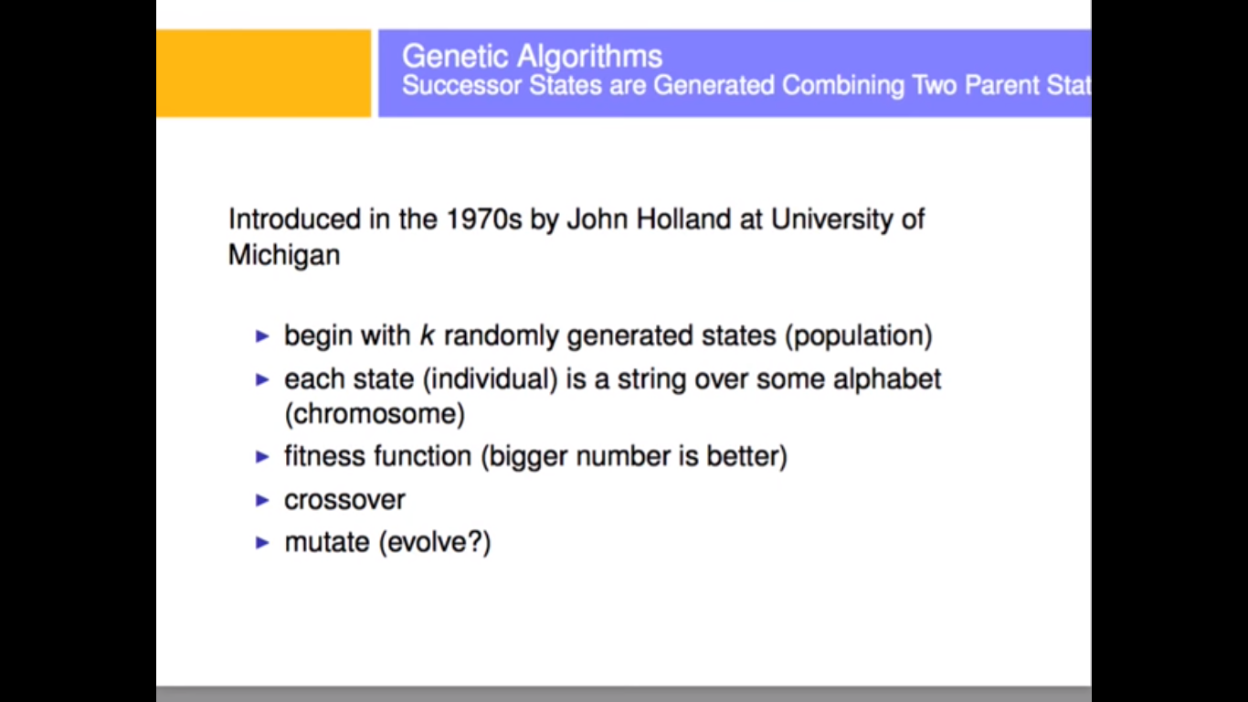

Slide 10
Formulation of Genetic Algorithm
John Holland introduced Genetic Algorithm (GA)
Darwin’s theory of evolution
Fitness function: number of non-attacking pairs of queens
Maximum number of pairs: 8 × 7/2 = 28
[Q1 Q2]
[Q1 Q3]
[Q1 Q4]
[Q1 Q5]
[Q1 Q6]
[Q1 Q7]
[Q1 Q8]
………
[Q8 Q7]
3 8 4 7 2 3 2 5
3 8 5 7 1 6 1 5
Fitness=28-7=21
Fitness=28-4=24
Chromosome of Father:
3 8 4 7 2 3 2 5
Chromosome of Mother:
3 8 5 7 1 6 1 5

Slide 11
Pseudo-code of GA:
START Generate the initial population Compute fitness REPEAT Selection Crossover Mutation Compute fitness UNTIL population has converged
STOP

Slide 12
Crossover:
Chromosome of Father:
3 8 4 7 2 3 2 5
Chromosome of Mother:
3 8 5 7 1 6 1 5
Chromosome of Father:
3 8 4 7 2 3 2 5
Chromosome of Mother:
3 8 5 7 1 6 1 5
Offspring 1:
3 8 4 7 1 6 1 5
Crossover point
Offspring2:
3 8 5 7 2 3 2 5
3 8 4 7 2 3 2 5
3 8 5 7 1 6 1 5
2 4 4 1 5 1 2 4
3 2 5 4 3 2 1 3

Slide 13
Mutation:
Before Mutation:
Offspring 1:
Offspring2:
Offspring 1:
3 8 4 7 1 6 1 5
Offspring2:
3 8 5 7 2 3 2 5
After Mutation:
Offspring 1:
3 8 4 7 1 6 2 5
3 8 4 7 1 6 2 5
3 8 6 7 2 3 2 5
Offspring2:
3 8 6 7 2 3 2 5
Fitness=28-0=28
Fitness=28-5=23

Slide 14
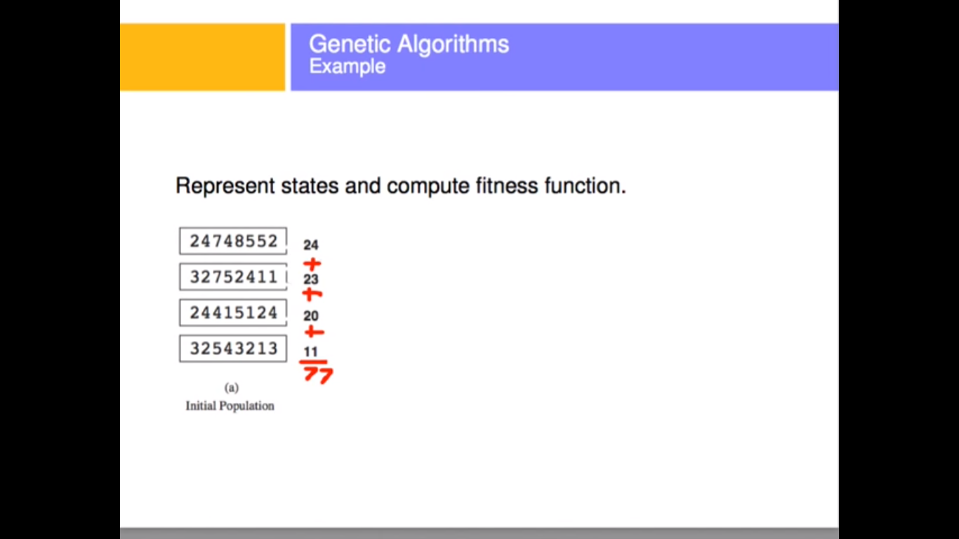

Slide 15
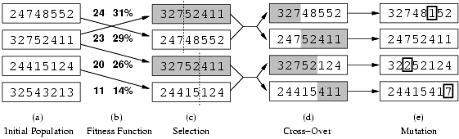
GENETIC ALGORITHMS
Fitness function: number of non-attacking pairs of queens (min = 0, max = 8 × 7/2 = 28) 24/(24+23+20+11) = 31% 23/(24+23+20+11) = 29% etc

Slide 16
Solution of 8-Queen Problem using Genetic Algorithm
John Holland introduced Genetic Algorithm (GA)
Darwin’s theory of evolution

Slide 17
The 4-Queen Problem
Fitness function: number of non-attacking pairs of queens
What is the Maximum fitness value: ????

Slide 18
4-Queen Problem Using Backtracking Approach
Therefore , the king called Professor John Holland of the University of Michigan to solve the 4-Queen problem. And solved the 4-Queen problem in backtracking approach.

Slide 19
Solution of the 4-Queen Problem Using GA
Initial Population

Slide 20
Conclusion
Application areas of GA:
Game programming
Cloud resource allocation
Job scheduling of operating systems
Channel assignment in communication system
Combinatorial optimization
Creative design (NASA antenna)
Operational research

Slide 21
REFERENCES
Fraser, Alex; Burnell, Donald (1970). Computer Models in Genetics. New York: McGraw-Hill.
Crosby, Jack L. (1973). Computer Simulation in Genetics. London: John Wiley & Sons.
UC Berkeley's Hans Bremermann, professor emeritus and pioneer in mathematical biology, has died at 69
Fogel, David B. (editor) (1998). Evolutionary Computation: The Fossil Record. New York: IEEE Press.
Barricelli, Nils Aall (1963). "Numerical testing of evolution theories. Part II. Preliminary tests of performance, symbiogenesis and terrestrial life". Acta Biotheoretica (16): 99–126.

Slide 22
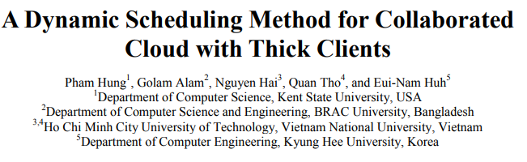
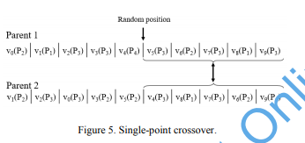
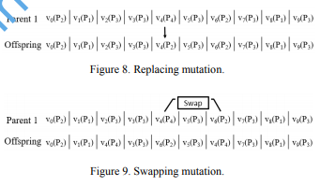
RESEARCH

